Slide 1

Unified Mentor, Gurugram, Haryana
Dissertation Project Report
On
Daily Transactions
Presented by:
Swapnil Prabhakar Chavan

Slide 2
Introduction
Objective: Analyze household transactions to find patterns in spending and income.
Importance: Supports budgeting, cost optimization, and financial planning.
Scope: Daily transactions from a household finance dataset.

Slide 3
Dataset Overview
CSV File: Daily Household Transactions.csv
Rows: ~2,461
Columns: Date, Mode, Category, Subcategory, Amount, Income/Expense, Currency
Mix of income and expense transactions
Missing values in Subcategory and Note columns

Slide 4
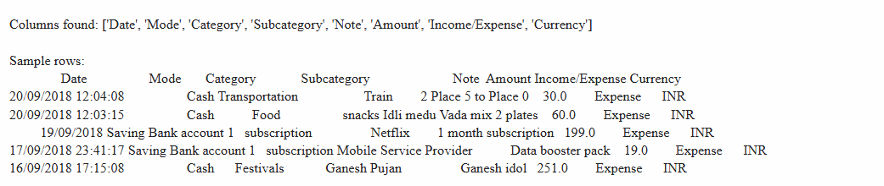

Slide 5




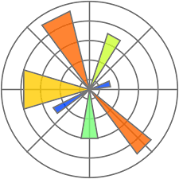

Tools & Libraries
Tools:
Python 3 with Jupyter Notebook
Libraries:
Pandas – Used for data cleaning & manipulation
Numpy – Used for numerical calculations
Matplotlib – Used for plotting and graphs
Seaborn – Used for advanced data visualization

Slide 6
Data Cleaning Steps
Removed duplicates
Handled missing values with fill or drop methods
Standardized text (lowercase, trimmed spaces)
Converted Amount to numeric values
Created new columns: Year, Month, Weekday, Signed Amount

Slide 7
Exploratory Data Analysis (EDA)
Transaction count by category
Transaction amount distribution (income positive, expense negative)
Most used payment modes
Average transaction size

Slide 8
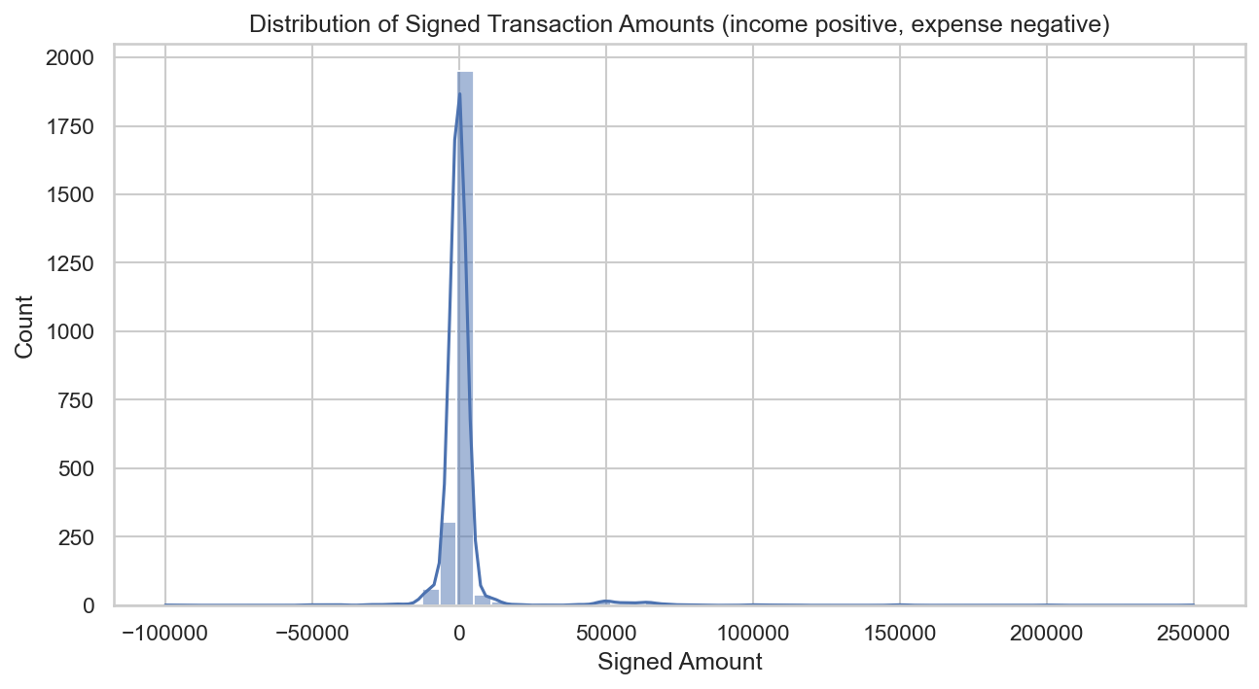

Slide 9
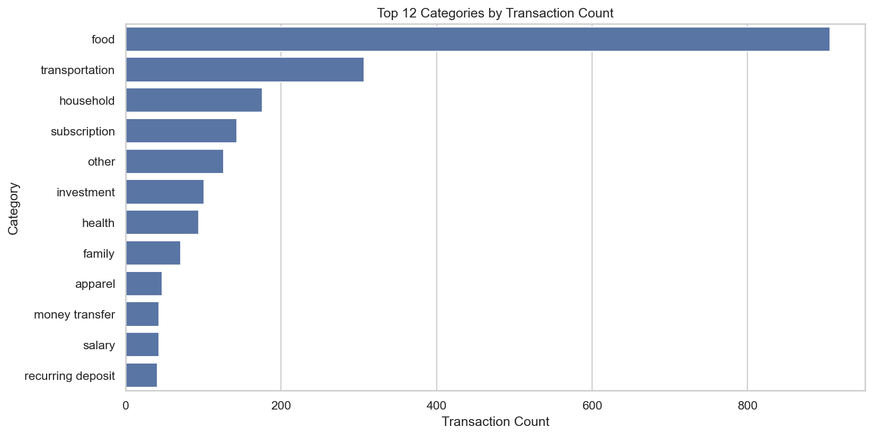

Slide 10
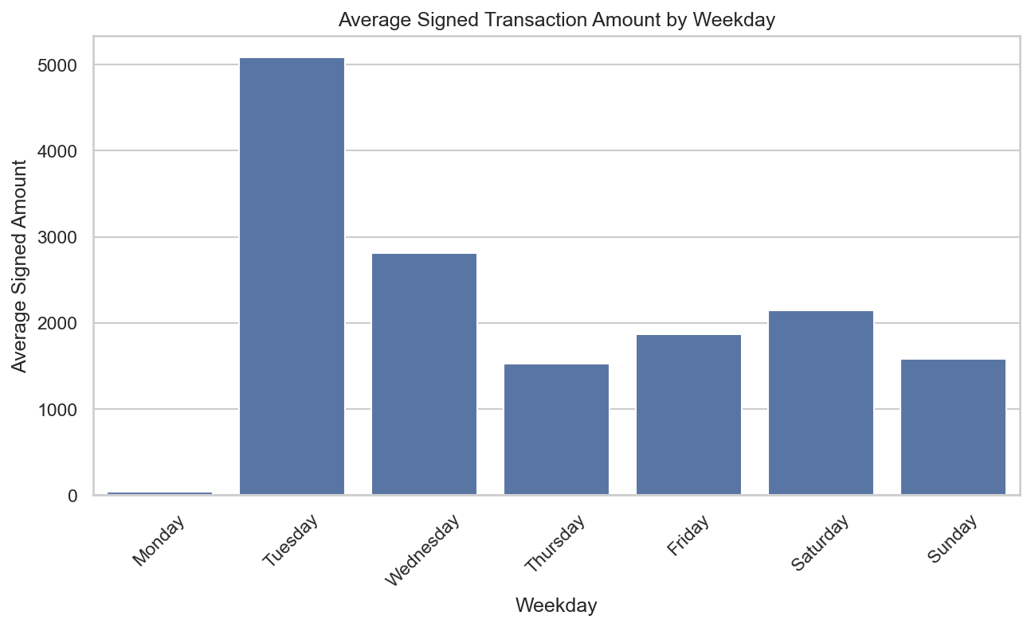

Slide 11
Time Series Trends
Monthly net balance trend
Rolling 7-day spending average
Seasonal peaks in expenses

Slide 12
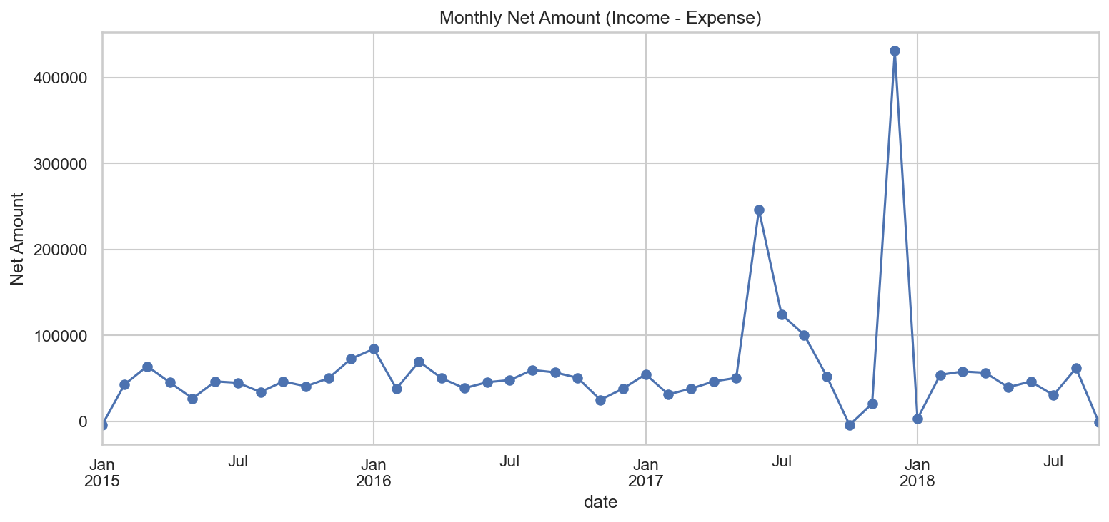

Slide 13
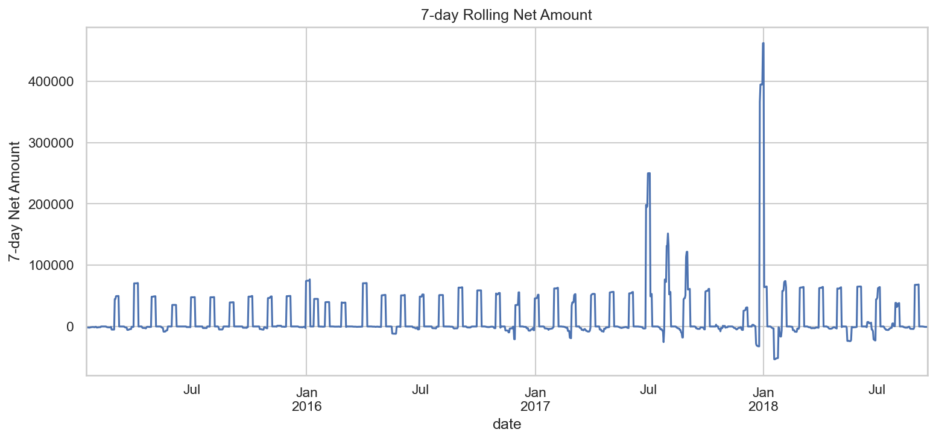

Slide 14
Category & Mode Analysis
Top expense categories share of spending
Relationship between payment mode and spending
Variations in transaction amounts by category

Slide 15
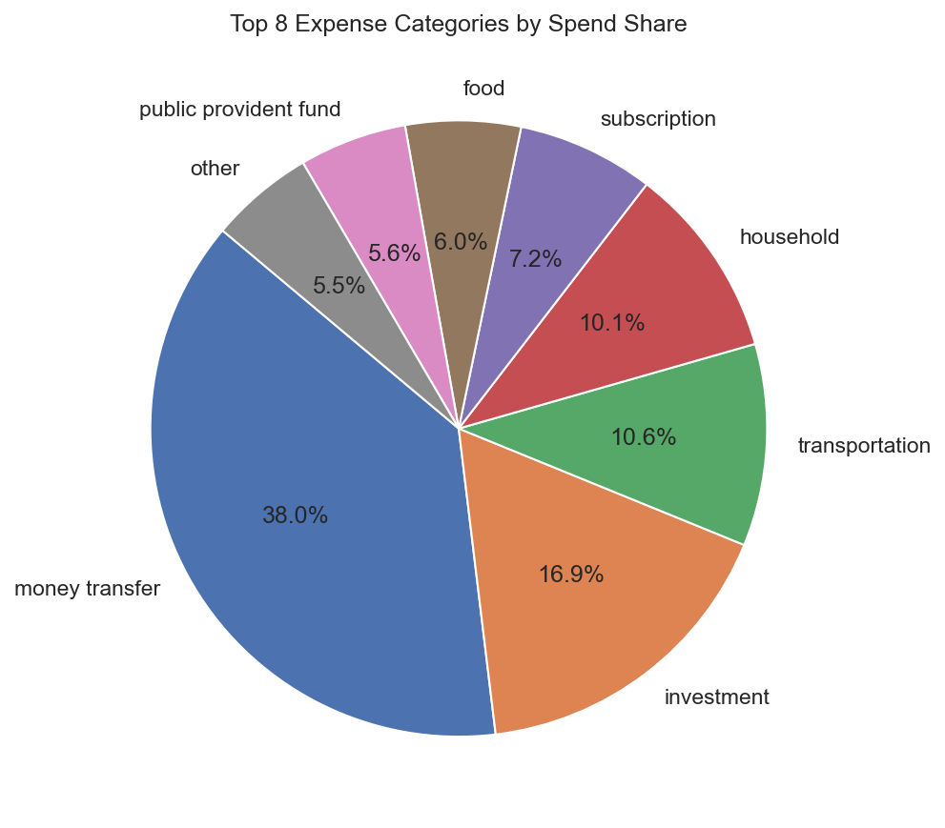

Slide 16
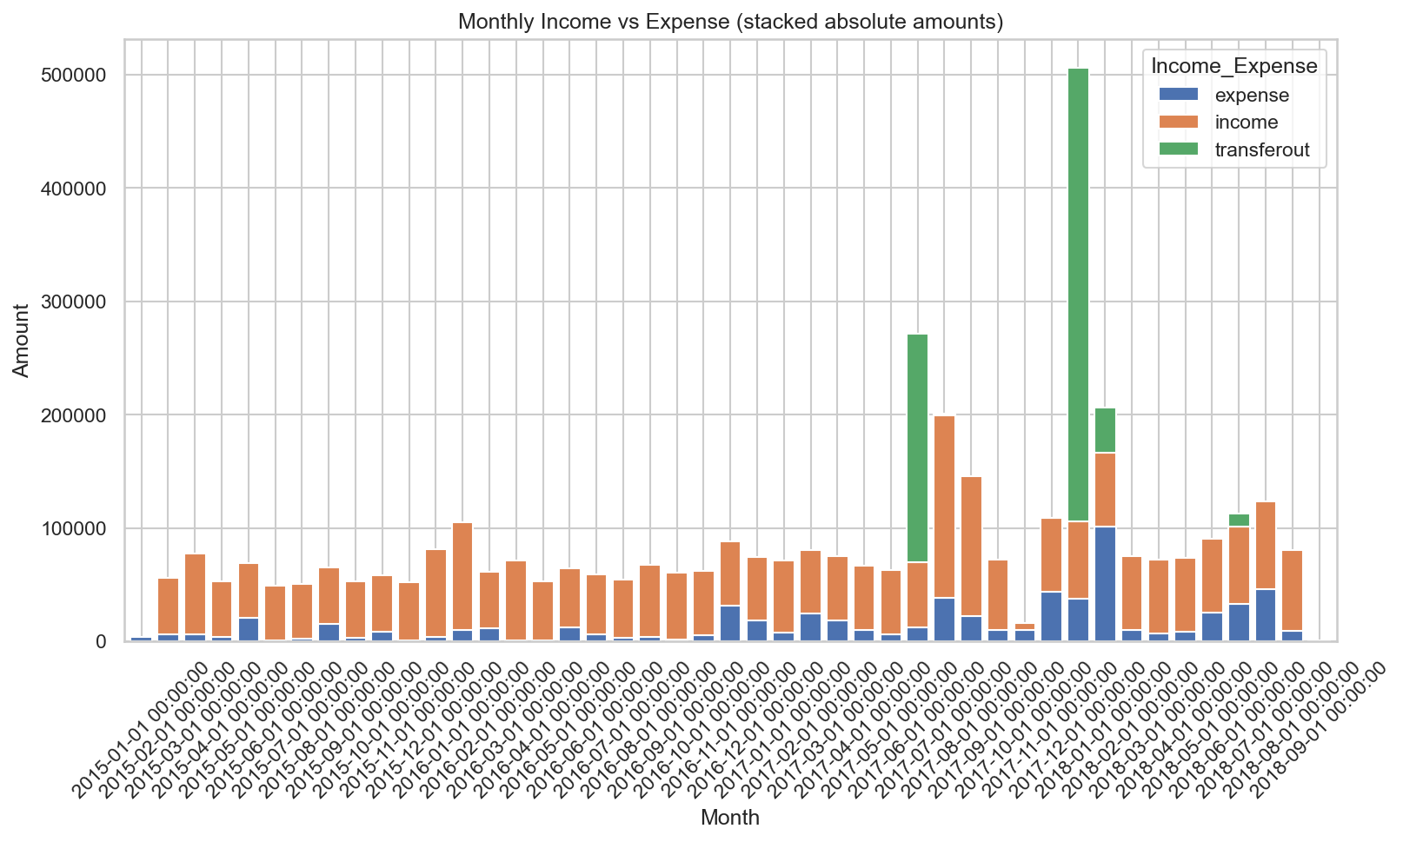

Slide 17
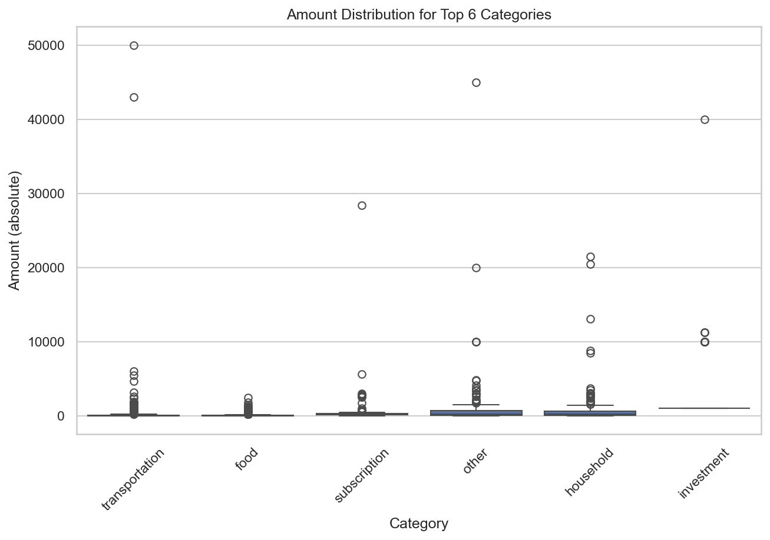

Slide 18
Correlation Analysis
Correlation between monthly category spends
Strong positive/negative relationships help spot related expense habits

Slide 19
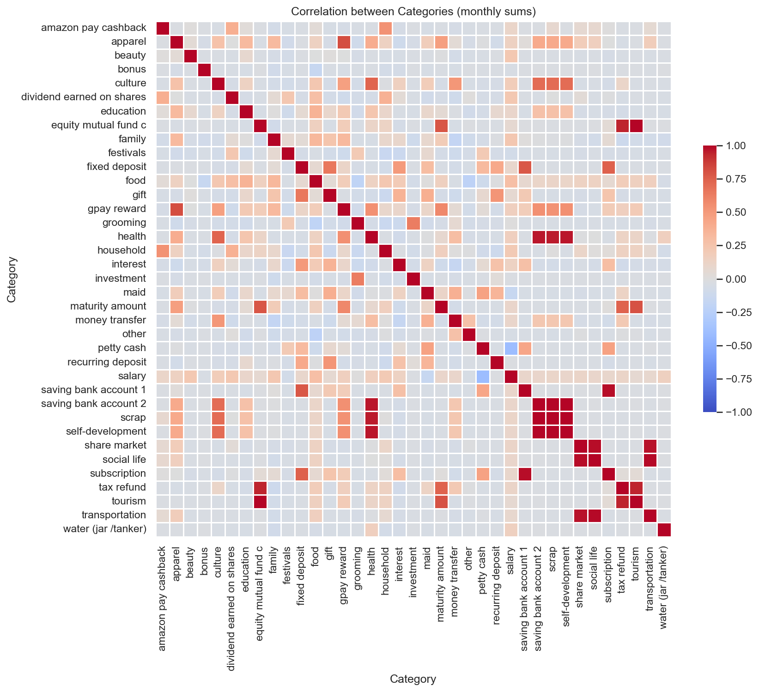

Slide 20
Conclusion & Recommendations
Summary: Spending dominated by a few categories, seasonal peaks, clear mode preferences
Recommendations:
  Reduce discretionary spending in top expense categories
  Allocate budget limits for high-expense months
  Consider more cost-efficient payment modes

Slide 21
Thank you!

